Slide 1
Research: save webpages to www.getpocket.com
Who was Cleon? What actions did he take? What was his personality like? Compare Cleon with a modern leader. What are the similarities and differences? | Who was Perikles? What were his ideas about leading society? How did he develop Athenian culture? How did Athenian citizens respond to him?
How did the Law Courts/judicial system function in ancient Athens? How much was a juror paid? How much ‘power’ did a juror have? Compare this ancient system with our modern NZ system of juries. Helpful link: http://www.justice.govt.nz/services/access-to-justice/jury-service-1/about-jury-service | Who was Aristophanes? Create a timeline of socio-political events during his life. Include the oligarchic revolutions, the Battle of Arginusae, Cleon, the year Wasps was written.

Slide 2
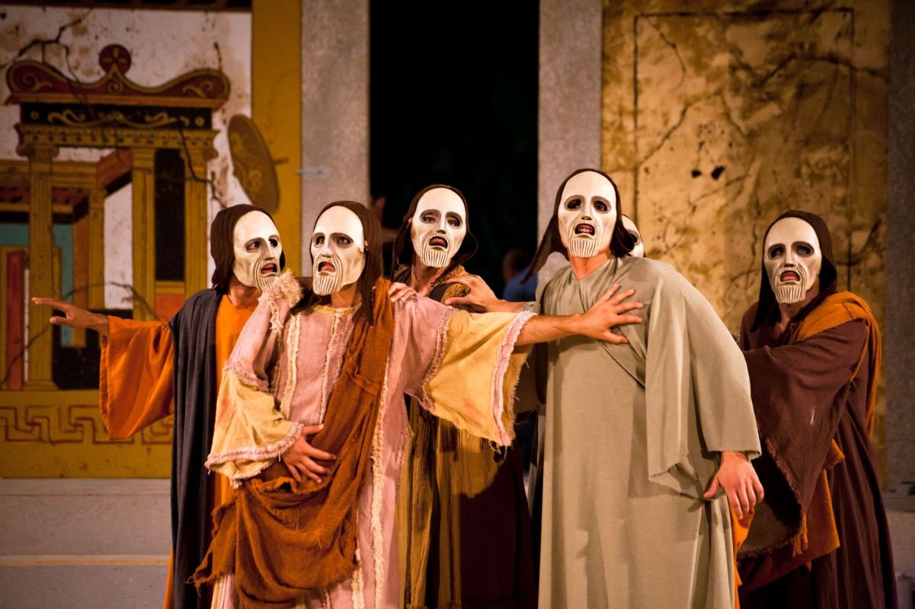
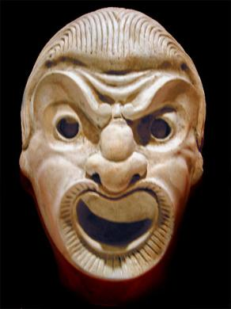
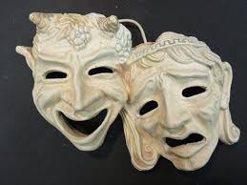
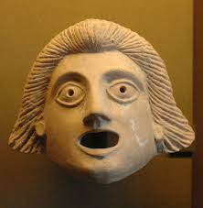
Masks and Costumes

Slide 3
Purposes of masks
Neutralised the actor’s own personality
Gaping mouth intended to produce resonance (amplify the actor’s voice)
Exaggerated features of the face so that they could be seen from the back of the theatre

Slide 4
In Aristophanes’ time, accurate caricatures as well as humorous and grotesque masks could be made
White masks represented female characters – red, for male
Exceptions showed abnormality, eg masks of philosophers may have been yellow to indicate lack of sun from studying.
Masks were exaggerated, with wide, over the top mouths and large eyes
Beards were old fashioned and pointed to show manliness
Some comic masks were a definite attempt to recreate the face of a living individual
Most masks represented general character types (eg farmers, slaves, soldiers, middle-aged men)

Slide 6
Greek drama masks
Advantages | Disadvantages

Slide 7
Greek drama masks
ADVANTAGES | DISADVANTAGES
Allowed one actor to switch roles and overcame problem of only three speaking actors per play Allowed male actors to play female parts. Women, like violence, were not allowed on the stage, which was a religious place Allowed faces to be seen easily at a distance because of the bold painting Pointed up grotesque foolishness of comic characters Allowed well-known Athenians to be deliberately caricatured Reinforces it as a ritual Shows strongest mood You can tell what type of play it was Can tell age of character Mouth acts as funnel Actors maintain anonymity Humorous | Ugly/grotesque Restrictions on actors facial expression, freezing the actor into a single, unchanged appearance Construction required (time, money) Maybe uncomfortable to wear Perhaps inhibit actors’ movements Quick changes could be difficult Have to say if expression different from mask e.g “I am crying.” Actors don’t get seen, miss out on fame??

Slide 8
Male Actors
“Skin” of the three male actors consisted of tights
Their stomachs were grotesquely padded
If playing a male role, a large leather phallus, generally a long floppy affair, was stitched to their tights
Over their tights, actors wore a sleeveless garment called a chiton
Over the chiton might be worn a long cloak called a himation
The Chorus
All the members of a comic chorus probably wore identical masks and costumes
The chorus apparently did not wear the phallus (though in The Wasps the chorus had stingers).
Costumes provided a vivid splash of colour (eg the chorus in the orchestra in their exotic costumes)
COSTUMES
Actors playing female parts
Actors playing female roles wore:
A whitened mask
A long flowing chiton that reached to the ground (often yellow)
A himation over the chiton was normally worn as a sort of a hood.

Slide 9
Conditions of Production

Slide 10
Poets
The playwrights were chosen by the archons (magistrate) who were appointed yearly through a ballet. The Archon Eponymus presided over the City Dionysia. The archons probably chose dramatists who were already established. These dramatists did not submit completed plays, but probably offered a detailed account of what they had in mind, and perhaps also read specimens of their work. The poets were paid for their work.

Slide 11
Actors
Actors were allocated for a performance and paid for by the state, and allocated to performances so that there would be no favouritism.

Slide 12
Choregos
This offical was assigned to each play. It was his job to hire the chorus, train it and fit it out at his own expense. Dramatists produced their own plays, but separate producers were not unknown. The richest citizens were asked to become choregoi.
In 406 and 405BC the duties of the choregos in both tragedy and comedy were divided between two men, because of economic conditions caused by the war.

Slide 13
Judging
Was very elaborate. Judges seem to have sworn an oath to be fair. 10 judges were chosen by a ballet when the competition opened from a hundred candidates who had in turn been chosen from a even larger number. At the end of each day, each judge placed his verdict in an urn: 5 of the urns (again selected by ballet) were opened, the rest ignored. This system made bribery (which was common) difficult, while the plays were judged by average citizens, not experts. The system of “allotment” allowed the gods a role in the judging!

Slide 14
Prizes
There were 3 prizes for comedy, but since the number of plays had been reduced from 5 to 3 as a war was going on, to receive third prize was no honour. The winning playwright, choregos and actors were awarded garlands of ivy. It is probable that there was financial award for the winning comic playwright.

