Slide 1
Topic: Was the Treaty of Versailles Fair? The BIG Questions What are arguments *for* the Treaty? What are arguments *against* the Treaty?
Key words for this lesson
Treaty of Brest-Litovsk
Reparations
Just [as in, fair or morally right]
Double standard
Agricultural land
pacifists
Historical concepts
Historical perspective
Evidence
Skills
Using evidence to prove a point
Seeing two sides of an argument
Speaking in front of others
Collaborating with classmates

Slide 2
Your task
Watch this video
Answer the quiz questions at the end – record them.
Record the evidence in a table.
4. Have these ready at the start of next lesson as evidence you watched the video before class.
The Treaty was fair on Germany | The Treaty was not fair on Germany

Slide 3
German reaction to the Treaty
Notes:
The German reaction to the Treaty was horror and outrage, as we saw last lesson. They certainly did not feel they’d started the war – they didn’t even feel they’d lost the war. In 1919 many Germans did not really understand how bad Germany’s military situation had been at the end of the war in 1918. They believed that Germans

Slide 4
German reaction to the Treaty
“Today in the Hall of Mirrors the disgraceful Treaty is being signed. Do not forget it! The German people will, with unceasing labour, press forward to reconquer the place among the nations to which it is entitled.”
From Deutsche Zeitung (German News), on the day the Treaty was signed

Slide 5
Double standards?
German complaints fell on deaf ears
In fact, many people felt that the Germans were themselves operating a double standard
They asked for fairer treatment but….

Slide 6
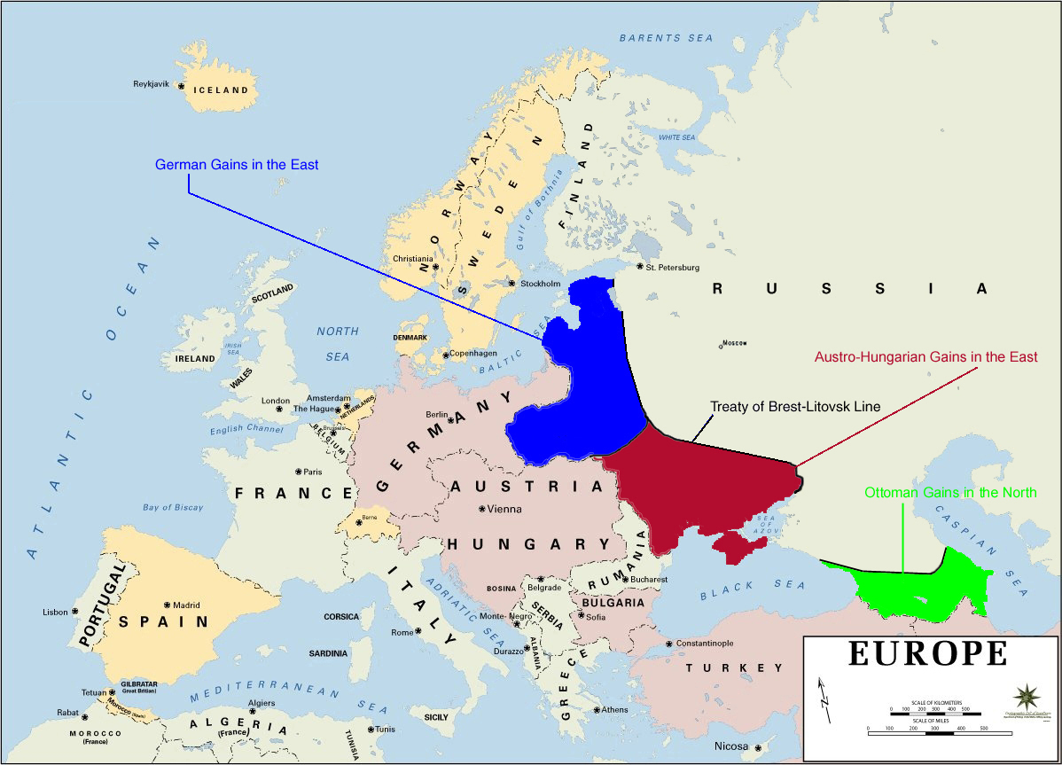
1. Treaty of Brest-Litovsk, 1918
German-made treaty for its peace/victory over Russia in WWI
Severe on Russia
Land lost:

Slide 7
1. Treaty of Brest-Litovsk, 1918
Russia lost
34% of its population to Germany and Austria-Hungary
32% of its agricultural land
54% of its industry
26% of its railways
89% of is coalmines
Russia forced to pay a fine of 300 million gold roubles

Slide 8
The Treaty the Germans forced on the Russians in early 1918 was harsher than the Treaty of Versailles
From the point of view of the Allies this was proof of the evil ambitions of the German government
They felt this is what the Germans would have done to them if it had won
“To the Allied Powers the Treaty of Brest-Litovsk was almost as significant as to the Russians and Germans who signed it. The naked and brutal annexation [take-over of land] as practiced by a victorious Germany weakened the arguments of well-meaning but misguided pacifists in the countries of the Entente [Allies – Britain and France].”
An extract from Purnell’s History of the War, written in 1969.

Slide 9
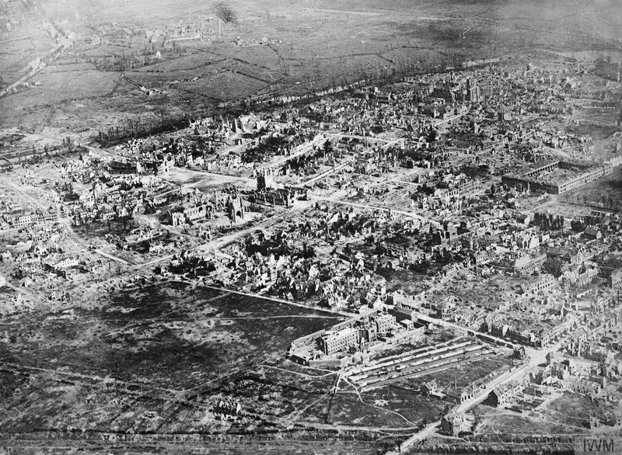
2. The Mood in 1919
People in France and Britain felt Germany should be punished because of all the damage of the war:
Exhausted
Economies in a bad state
Total British and French casualties = 9 million
Villages and towns in large areas of Belgium and France were devastated

Slide 10
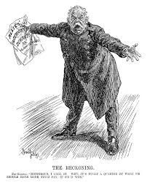
3. Germany’s economic problems were partly self-inflicted
Instead of raising taxes to fund the war (like the Allies did), the German government had gone into debt - they planned to pay the debts by extracting reparations from the defeated states (when they won)
The Reckoning
Pan-German: “Monstrous I call it. Why, it’s fully a quarter of what we should have made them pay, if we’d won.”
- A cartoon from Punch magazine, 1919

Slide 11
Verdicts on the Treaty of Versailles
Criticised not only by Germans
None of the Big 3 were satisfied with it:
Clemenceau – not harsh enough (and in 1920 he was voted out!)
Lloyd George – ‘a great pity’ – believed another war would happen because of it
Wilson – disappointed – if he were a German he would not have signed it. The American Congress [parliament] refused to approve the Treaty.

Slide 12
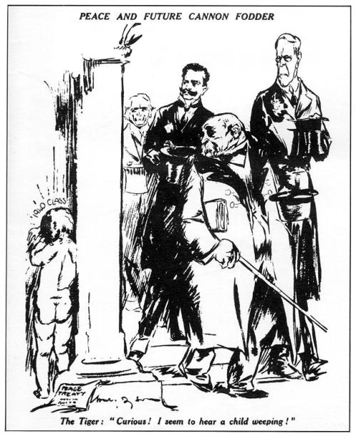
Four views from Britain
“severe as the Treaty seemed to many Germans, it should be remembered that Germany might easily have fared much worse. If Clemenceau had had his way… the Rhineland would have become an independent state and Danzig would have become a part of Poland.”
British historian W Carr, A History of Germany, 1972.
“…a fair judgement upon the settlement, a simple explanation of how it arose, cannot leave the authors of the new map of Europe under serious reproach. To an overwhelming extent the wishes of the various populations prevailed.”
Winston Churchill, speaking in 1919. He had been a member of the government during the war.
“The historian, with every justification, will come to the conclusion that we were very stupid men…we arrived determined that a Peace of justice and wisdom should be negotiated; we left the conference conscious that the treaties imposed upon our enemies were neither just nor wise.”
Harold Nicolson, British diplomat. He was one of the leading British officials at the Conference

Slide 13
History judges….
Now that we have the benefit of hindsight (looking back, knowing what we know)…
The Treaty helped to create a cruel regime in Germany and eventually a second world war
Historians’ judgements tend to side with the critics of the Treaty
At the time, however, many outside Germany felt it was fair (or not harsh enough)
A more generous treaty would have been totally unacceptable to public opinion in Britain or France
How hard it was to agree to a peace settlement – was it the best that could be hoped for in the circumstances?

Slide 14
Quiz
What was the German reaction to the Treaty?
Germans felt that at the Paris Peace Conference, they should not have been treated as ________.
Three reasons why the Treaty was fair are….
Did British historian W Carr feel the Treaty was too harsh?
Was the Treaty acceptable to the people of Britain and France?
How did each of the Big 3 feel about the Treaty?

