Slide 1
Who was Aristophanes?

Slide 2
Born c.446 in Athens
He was a comic playwright and poet
Known as the ‘Prince of Comedy’
He wrote 40 plays
11 of them have survived in their entirety
He is famous for his satire and ridicule of political figures and political situations
He died in c. 386BC

Slide 3
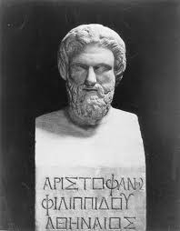
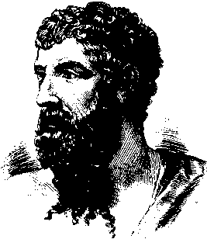

Slide 4
His Plays
The Acharnians – 425BC
The Knights – 424BC
The Clouds – 423BC
The Wasps – 422BC
Peace – 421BC
The Birds – 414BC
Lysistrata – 411BC
Thesmophoriazusae – 411BC
The Frogs – 405BC
Ecclesiazusae – 392BC
Wealth II – 388BC

Slide 5
Historic Background of Aristophanes

Slide 6
The Persian Wars 492-480BC
Sparta wished to dominate the Greek city-states in their war against the Persians.
However, Athens emerged as leader through 2 crucial wins
Marathon (490BC)
Salamis (480BC)
These victories caused Sparta to become jealous of Athens

Slide 7
Golden Age of Athens
Persian Defeat = democracy Boom in Athens
Following the Persian defeat at Salamis, Athens entered a golden age
Athens achieved supremacy in politics, art, architecture, philosophy and science.
This was under the leadership and influence of Pericles
It was during this time that Athens moved from a city-state to an empire

Slide 8
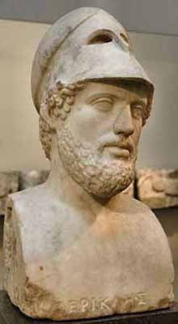
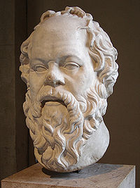

Slide 9
Delian League
This was a loose association of states allied to Athens from 477-404BC.
The association was called the Delian League
It was named after the Leagues meeting place, the island of Delos
Here was housed the Leagues gold.
Soon after its creation, Athens exploited the Delian League for money and its navy
Following rebellion, Pericles suppressed the independence of its allies and turned them into colonies of Athens.

Slide 10
The Peloponnesian League
To counter the Delian League, Sparta formed its own association of allies
It was called the Peloponnesian League
Sparta forced the minor states around it to submit to its dominance.
Eventually, the two leagues begun to fight against each other
The Peloponnesian War had begun.

Slide 11
Differences
Athens
Sparta
Progressive
Liberal
Expansionist
Democratic
Conservative
Aristocratic
Autocratic
Inward looking
This deep divisions caused a lot of mistrust between Athens and Sparta.

Slide 12
Athens vs. Sparta
Sparta and its allies were land-based powers
They were able to summon massive armies
Most of these were considered ‘unbeatable’
The Athenian Empire was very spread out
Based in Attica and across the Greek isles
Athens relied on tribute from these islands
To maintain this empire, Athens kept a massive navy

Slide 13
Phase 1 – The Archidamian War (431-421BC)
Spartan strategy
Athenian Strategy
Sparta launched repeated invasions of Attica
Deprived Athens of land
Very little affect however
Sparta only occupied Athenian land for 3 week periods
Harvest
Slavery issues
Avoid Spartan army
Raided the Peloponnese with its navy
Won the Battle of Naupactus
However, plague struck in 430
30,000 killed including its general, Pericles
Athens rejected the defensive stance and adopted an aggressive strategy
This was under the leadership of Cleon
Peace broke out between the two in 421BC with the Peace of Nicias

Slide 14
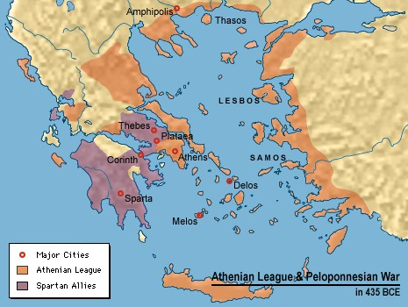

Slide 15
Pericles vs. Cleon
Pericles
Cleon
Pericles favoured a defensive strategy towards Sparta
Opted to use the navy to gain success
He knew Sparta could not be beaten in the field
Pericles died in 429BC during the plague
Appealed via oratory skills and war-like attitude
Cleon was a hawkish leader who favoured an aggressive war
Take the war to Sparta
He also misled the people as to the extent of war itself
Cleon was killed in battle in 422BC

Slide 16
Sicilian Expedition – 415BC
Athens launched an expedition to Sicily
It was supported by the statesman Alcibiades and led by Demosthenes
The mission was hampered from the start
Its purpose was uncertain
No definite command structure
The expedition ended in disaster
Every single crewmen was either killed, captured or sold into slavery

Slide 17
The Second War (413-405)
In this phase, Sparta received support directly from Persia.
They actively support rebellion within Athens allies
Eventually destroyed Athens naval supremacy
With the Athenian fleet destroyed the war came to quick end.
Athens surrendered and submitted itself to Sparta

Slide 18
Athens after the war
Democracy was suspended in Athens
Rule was given to a pro-Spartan oligarchy called the Thirty Tyrants
By 403 the oligarcies were overthrown and democracy returned
Sparta maintained its dominance of Greece until Philip of Macedon destroyed their power base.

